Slide 1
The NYISO’s Carbon Pricing Proposal
The Value Proposition to New York
Sue Tierney
Senior Advisor, Analysis Group
Energy Policy Roundtable in the PJM Footprint: Carbon Pricing
April 28, 2020

Slide 2
Overview
The essence of the NYISO carbon-pricing proposal
Analysis Group’s study
The value proposition of the proposal for New York
Insights relevant for PJM

Slide 3
The NYISO carbon-pricing proposal
Suppliers’ offer prices (energy market)
NYISO’s carbon price adjustment
Fossil: + SCC adder
Nuclear: no adder
Wind, Storage:
No adder
Solar, demand-side:
No adder
Imports: + adder

Slide 4
The NYISO carbon-pricing proposal
Suppliers’ offer prices (energy market)
NYISO’s carbon price adjustment
NYISO dispatch & energy-market prices
Fossil: + SCC adder
Nuclear: no adder
Dispatch:
Based on offers with carbon prices
Clearing price:
Based on offer of marginal unit with carbon adder
Wind, Storage:
No adder
Solar, demand-side:
No adder
Imports: + adder

Slide 5
The NYISO carbon-pricing proposal
Suppliers’ offer prices (energy market)
NYISO’s carbon price adjustment
NYISO dispatch & energy-market prices
NYISO Settlement
Zero-carbon resources:
They’re paid the Clearing price
Fossil resources:
They’re paid the offer price
Imports:
They’re paid the offer price
Carbon residuals:
Δ between fossil offer prices without carbon and clearing prices
Loads:
They pay clearing prices less credit reflecting share of carbon residuals
Fossil: + SCC adder
Nuclear: no adder
Dispatch:
Based on offers with carbon prices
Clearing price:
Based on offer of marginal unit with carbon adder
Wind, Storage:
No adder
Solar, demand-side:
No adder
Imports: + adder

Slide 6
The context: New York has among the strongest set of statutory climate policies in the U.S.
New York’s new Climate Leadership and Community Protection Act (June 2019)
1990 2020 2030 2040 2050
Electric system 70% renewables
Electric System 100% zero-carbon resources
+6,000 MW solar
3,000 MW energy storage
+9,000 MW offshore wind
+5%
energy efficiency
Economy 40% lower emissions
Economy 85% lower emissions
Specific resource targets are incremental to existing plans.

Slide 7
The context: New York’s GHG Emissions: 1990-2016 (actual), with statutory targets
85% reduction in GHG emissions by 2050 (relative to 1990)
future requirements
Other sectors besides electricity
-40%
electricity
-85%

Slide 8
The context: New York’s GHG Emissions: 1990-2016 (actual), with statutory targets
85% reduction in GHG emissions by 2050 (relative to 1990)
future requirements
actual
-13%
other
industrial
transportation
-40%
buildings
electricity
-85%
2020
https://www.nyserda.ny.gov/About/Publications/EA-Reports-and-Studies/Greenhouse-Gas-Inventory

Slide 9
Meeting these requirements is important – but will not be easy
NY should use every effective tool available to get the job done, in the most efficient, lowest-cost way
The Act envisions use of diverse of policy instruments—ASAP— including long-term contracts, efficiency standards, financial incentives.
It will also require further innovation in policy, markets, technology, business models, financing, service-delivery mechanisms, workforce training, and many other things.
https://www.swissarmy.com/us/en/Products/Swiss-Army-Knives/Medium-Pocket-Knives/Huntsman/p/1.3713

Slide 10
New York’s Act explicitly envisions a big role for the electric grid
New York’s low-carbon economy will depend on a vibrant, efficient and reliable electric system
NY’s electric sector emits a relatively small share of GHG emissions at present.
It will phase out GHG emissions over 2 decades.
Buildings and the transportation sector account for 60% of emissions, and the Act anticipates electrification of these end uses.
As the electric system shifts to rely more on renewables and zero-carbon resources, demand for electricity will increase substantially.

Slide 11
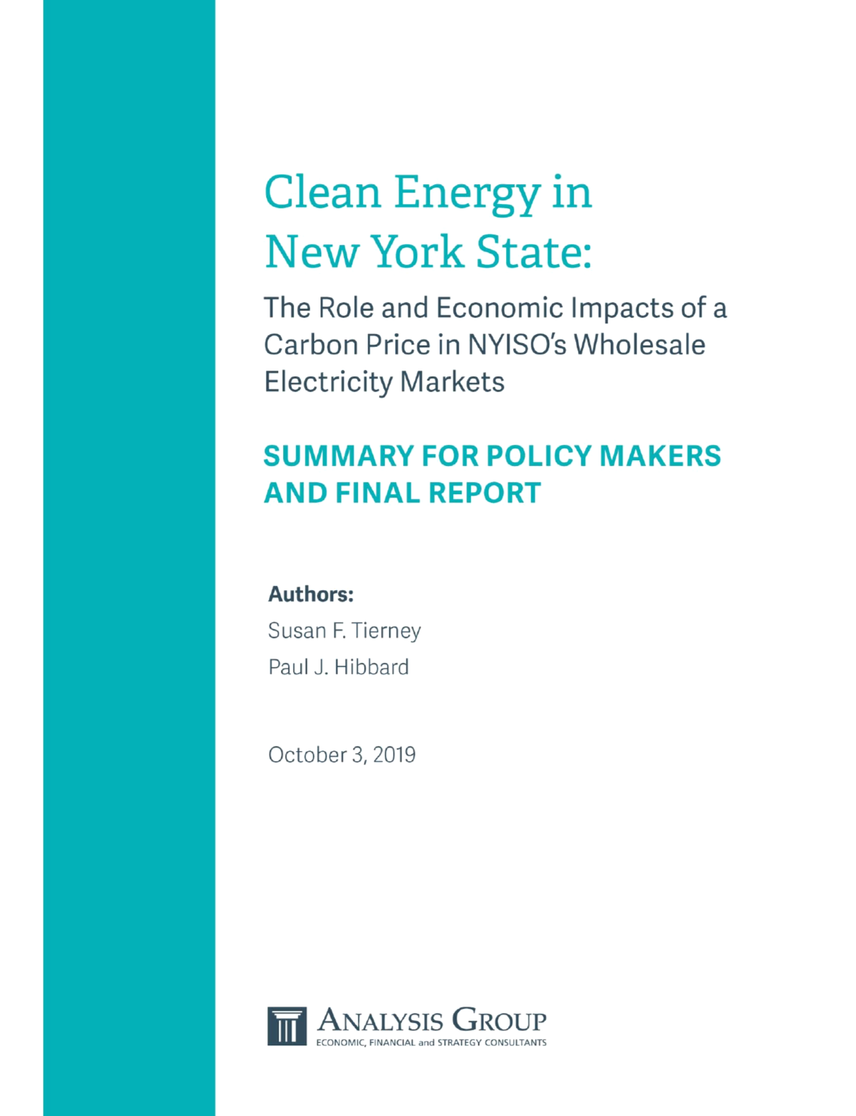
Our analysis of the NYISO proposal
We examined:
how NYISO’s proposed carbon-pricing mechanism can help the State meet its new statutory requirements for decarbonizing the electric system through efficient market design and at the lowest cost, and
how New York’s wholesale competitive electric markets can help the state achieve its climate goals more broadly, efficiently, and effectively.
https://www.analysisgroup.com/globalassets/uploadedfiles/content/news_and_events/news/2019-analysis-group-nyiso-final-report.pdf

Slide 12
A NYISO carbon price can help deliver NY’s clean-energy transition…
…in faster, cheaper, more reliable, more efficient, and more creative ways
A carbon price will send price signals to investors, entrepreneurs, service providers, project developers to:
create innovative solutions and projects;
locate renewable projects closer to load centers;
offer inventive and attractive services to help consumers reduce their demand;
reduce emissions from fossil-fuel power plants that affect vulnerable communities; and
invest in additional transmission capacity to open up downstate New Yorkers’ access to plentiful and relatively cheap zero-carbon/renewable resources in upstate New York.

Slide 13
A carbon price in NYISO markets would create synergy …
…between the state’s wholesale electricity market design and the Act’s GHG-reduction targets
A carbon price will position investment and operations to row in the direction of NY’s climate goals.
NY’s electric system needs to move quickly towards a lower-carbon footprint, even as it grows with electrification.
NYISO’s market design needs to internalize a carbon price so it can send efficient price signals to market participants about the value of zero-carbon energy resources, along with system conditions and needs.
Investors and developers depend upon such signals as they consider the types of investments, services, operational expenditures, and projects they bring to the system, and when and where to locate them.

Slide 14
A carbon price can work hand in hand with other policies
The Act is a call for all hands on deck to address GHG emissions
Aligning the NYISO market design with NY’s climate goals will help renewable energy and storage to enter the market at a pace much faster than NY has ever seen
It would complement and accelerate the impact of other state policies (e.g., NYSERDA’s competitive solicitations and long-term procurements of RECs and ZECs).
It would provide an economic basis to avoid FERC action to mitigate New York’s market and avoid consumer cost impacts of such mitigation policies.

Slide 15
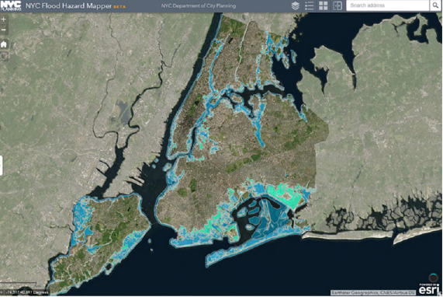
There will be out-of-pocket costs to transition NY’s energy economy
A price on carbon in NYISO’s market would help keep the costs lower than they otherwise would be
NY policy makers have decided that the costs of climate change are significant enough to warrant urgent, aggressive action to transition the state’s economy away from fossil fuels.
Incorporating the Social Cost of Carbon into NYISO energy markets will be an efficient way to reduce emissions.
Studies of the NYISO pricing mechanism indicate billions of dollars of consumer benefits.
https://www1.nyc.gov/site/planning/data-maps/flood-hazard-mapper.page

Slide 16
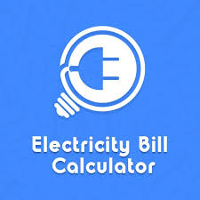
The value proposition of NYISO’s carbon-pricing proposal: The numbers
Estimates of consumer impacts are complicated (1)
Our study reports on others’ modeling of the impacts on consumer costs:
These studies preceded NY’s climate Act and assumed more modest goals (depth, timing) for reducing carbon. The studies looked at impacts in 2025, or through 2030.
Brattle and Potomac Economics modeled a base case (no carbon pricing) that assumed NY met its renewables targets at no cost, and then looked at the incremental impact of the carbon price.
Even so, the results indicate $ billions of economic benefits. These results are conservative.
We also estimated a number of other economic impacts, e.g.:
Market-efficiency savings.
Costs of potential FERC action to mitigate buyer-side market power.

Slide 17
The value proposition of NYISO’s carbon-pricing proposal: The numbers
Estimates of consumer impacts are complicated (2)
We report the results of others’ modeling of the impacts on consumer costs:
Resources for the Future (2019): $118–$755 m/year (2019$) in social welfare benefits (in 2025)*
Potomac Economics (2019): $1.72-$3.25 b (NPV, 2019$) in benefits to NY consumers (2022-2030)*
Brattle/IPPTF (2018): $119–$605 m (NPV, 2019$) in benefits to NY consumers (2022-2030)*
Our analyses:
Market efficiency: $280-$850 m (NPV, 2019$) in benefits to NY consumers (2022-2040)
Hypothetical FERC Buyer-Side Mitigation: Reduces the risk of significant cost exposure associated with increasing reliance on out-of-market approaches (e.g., state-mandated long-term contracts) to achieve NY’s aggressive climate goals.
* RFF results are expressed in 2013$; we converted them to 2019$. Results from Potomac Economics and Brattle were provided in annual $ impacts; we converted them to NPV $.

Slide 18
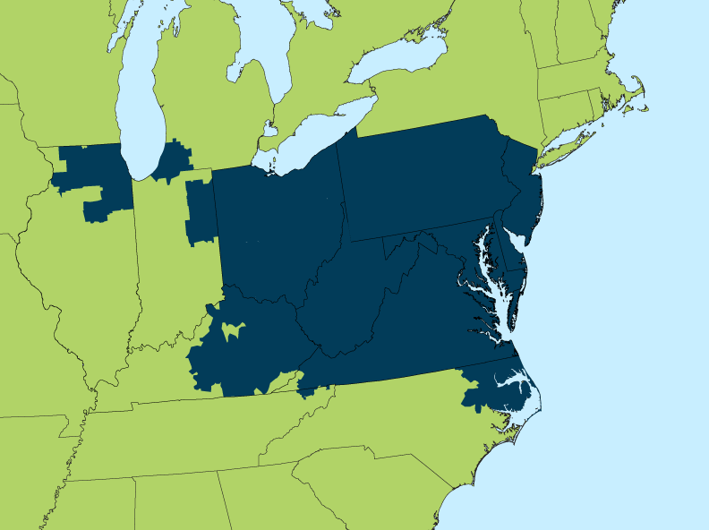
Insights relevant for PJM
Take-aways from our assessment of the NYISO carbon pricing proposal
✓
For states with climate or clean-energy goals ( ), the absence of a carbon price in the electricity market makes it harder to achieve those goals and to do so efficiently.
A carbon price harnesses the power of the market to row in the direction of state goals.
It helps drive down GHG emissions in cheaper, more reliable, and more creative ways.
It can work side-by-side with other policies. And without a price on carbon, all of the other policies have to do so much more of the heavy lifting.
✓
✓
✓
✓
✓
✓
✓
✓
✓

Slide 19
Susan F. Tierney, Ph.D.
Senior Advisor, Analysis Group
susan.tierney@analysisgroup.com
617-425-8114
Analysisgroup.com

